Slide 1


MATHEMATICAL INDUCTION
LECTURE 10
Adapted from :
https://www.genrica.com/vustuff/MTH202/MTH202_handouts_1_45.pdf

Slide 2
Learning Outcomes
After completing this course satisfactorily, a student will:
• Be able to construct simple mathematical proofs and possess the ability to
verify them.
Have substantial experience to comprehend formal logical arguments.
• Gain experience in using various techniques of mathematical induction
(weak, strong and structural induction) to prove simple mathematical
properties of a variety of discrete structures.

Slide 5
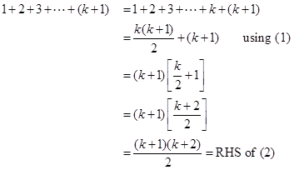
Hence by principle of Mathematical Induction the given result true for all integers greater or equal to 1.

Slide 6
EXERCISE:
Use mathematical induction to prove that
1+3+5+…+(2n -1) = n² for all integers n ≥1.
SOLUTION:
Let P(n) be the equation 1+3+5+…+(2n -1) = n²
Basis Step:
P(1) is true
For n = 1, L.H.S of P(1) = 1and
R.H.S =2(1)-1 = 1
Hence the equation is true for n = 1
2. Inductive Step:
Suppose P(k) is true for some integer k ≥ 1. That is,
1 + 3 + 5 + … + (2k - 1) = k² …………………(1)
To prove P(k+1) is true; i.e.,
1 + 3 + 5 + … +[2(k+1)-1] = (k+1) ² ………….……(2)

Slide 7
EXERCISE:
Use mathematical induction to prove that
1+2+2² + … + 2^{n} = 2^{n+1} - 1 for all integers n ≥0
SOLUTION:
Let P(n): 1 + 2 + 2² + … + 2^{n} = 2^{n+1} - 1
Basis Step:
P(0) is true.
For n = 0
L.H.S of P(0) = 1
R.H.S of P(0) = 2⁰⁺¹ - 1 = 2 - 1 = 1
Hence P(0) is true.

Slide 8
2. Inductive Step:
Suppose P(k) is true for some integer k ≥ 0; i.e.,
1+2+2²+…+2^{k} = 2^{k+1} – 1……………………(1)
To prove P(k+1) is true, i.e.,
1+2+2²+…+2^{k+1} = 2^{k+1+1} – 1…………………(2)
Consider LHS of equation (2)
1+2+2²+…+2^{k+1}= (1+2+2²+…+2^{k}) + 2^{k+1}
= (2^{k+1} - 1) +2^{k+1}
= 2·2^{k+1} - 1
= 2^{k+1+1} - 1 = R.H.S of (2)
Hence P(k+1) is true and consequently by mathematical induction the given propositional function is true for all integers n≥0.

Slide 10
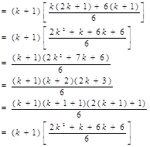

Slide 11
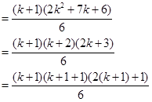

Slide 12
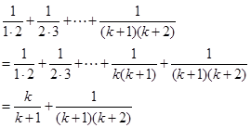

Slide 13
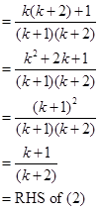
Hence P(k+1) is also true and so by Mathematical induction the given equation is true for all integers n ≥1.

Slide 14
Review Questions
Write down steps of Mathematical Induction

Slide 15
Thank you
Insert the title of your subtitle Here

